Slide 1
CAPSTONE PROJECT DATING A SCIENTIST
Machine Learning Fundamentals
Abdulmalik Aiyeleso
abdmaliqq@gmail.com
6th January, 2019

Slide 2
TABLE OF CONTENTS
Exploration of the Dataset
Statement of Questions
Augmenting the Dataset
Classification Approaches
Regression Approaches
Conclusion/Next Steps

Slide 3
EXPLORATION OF THE DATASET
I explored the dataset using .head(), .columns() and .value_counts(). There were 31 columns with various types of data.
‘height’, income’, ‘last_online and ‘age’ columns had numerical data while the other columns were mostly categorical data.
I wanted to dig further into the numerical data, so I made a histogram of the ‘income’, height and ‘age’ column.
I also checked the value_count of other columns

Slide 4
EXPLORATION OF THE DATASET
INCOME VALUE_COUNT
Observations
Data | Counts | %
500000 | 48 | 0.080072
250000 | 149 | 0.248557
1000000 | 521 | 0.869116
150000 | 631 | 1.052614
70000 | 707 | 1.179395
60000 | 736 | 1.227772
50000 | 975 | 1.626464
40000 | 1005 | 1.676509
30000 | 1048 | 1.748240
80000 | 1111 | 1.853335
100000 | 1621 | 2.704100
20000 | 2952 | 4.924432
-1 | 48442 | 80.809395
About 81% in the incomes were recorded as -1
Its difficult to do the analysis with 81% income recorded as -1

Slide 5
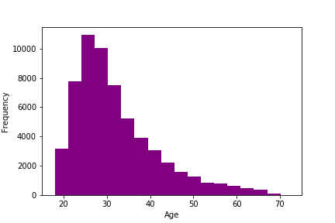
EXPLORATION OF THE DATASET
AGE HISTOGRAM
Most of the ages are within 25 – 35yrs

Slide 6
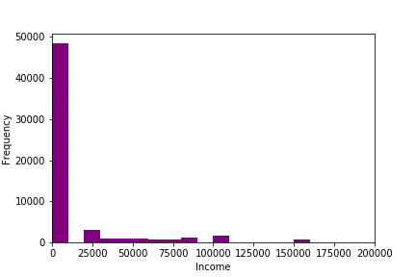
EXPLORATION OF THE DATASET
INCOME HISTOGRAM
About 80% of the incomes were recorded as -1
Data is highly imbalanced

Slide 7
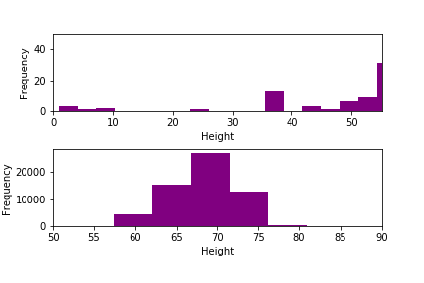
EXPLORATION OF THE DATASET
HEIGHT HISTOGRAM
Most of the heights are within 65 – 75yrs
Units of measurement not stated. This makes it difficult to know weather the values below 10 are actually valid or not.
Note: I replaced all the Nan with the mean height

Slide 8
EXPLORATION OF THE DATASET
STATUS VALUE_COUNT
Observations
Data | Counts | %
unknown | 10 | 0.016682
married | 310 | 0.517132
available | 1865 | 3.111133
seeing someone | 2064 | 3.443099
single | 55697 | 92.911954
About 93% indicated status as single
Another 3% indicated status as available
Data is highly imbalanced

Slide 9
STATEMENT OF QUESTIONS
Majority of the users on a dating website are single and/or available for dating.
This means there is a pool of data on single people on the website.
I was curious to see if a model can be built to predict a person’s status based on some specific features
I was also curious to know the relationship between age and status with some selected features

Slide 10
AUGMENTING THE DATASET - 1
In augmenting the data, I created new columns to create numerical data from categorical data in the following columns;
‘diet’
‘drinks’
‘drugs’
‘education’
‘job’
‘offspring’
‘pets’
‘smokes’
‘status’

Slide 11
AUGMENTING THE DATASET - 1
‘diet’
Users with specific diets were mapped as 1 while diets that were not specific were mapped as 0 in a new column named ‘diet_mapped’. All Nans were replaced with 0
‘drinks’
Users were mapped based on frequency of drinking in a new column named ‘drinks_mapped’. All Nans were replaced with 0
‘drugs’
Users were mapped based on frequency of drugs in a new column named ‘drugs_mapped’. All Nans were replaced with 0

Slide 12
AUGMENTING THE DATASET - 1
‘education’
Users that have graduated from a tertiary institution were mapped as 1 while others were mapped as 0 in a new column named ‘education_mapped’. All Nans were replaced with 0
‘job’
Users with specified jobs were mapped as 1 while students, unemployed and retired users others were mapped as 0 in a new column named ‘job_mapped’. All Nans were replaced with 0
‘offspring’
Users with no offspring stated in the data were mapped as 0 and 1 where there is one or more offspring in a new column named ‘off_spring_mapped’. All Nans were replaced with 0

Slide 13
AUGMENTING THE DATASET - 1
‘pets’
Users were mapped as 1 where the data shows there is a like for either dog or cat and 0 where there is none and doesn't want any in a new column named ‘pet_mapped’. All Nans were replaced with 0
‘smokes’
Users were mapped based on frequency of smoking in a new column named ‘smokes_mapped’. All Nans were replaced with 0
‘status’
Users were mapped based on availability for dating. ‘singles and ‘available’ were mapped as ‘True’ while married and unknown were mapped as ‘False’. All Nans were replaced with ‘False’

Slide 14
CLASSIFICATION APPROACHES
K-Neighbours classifier and Support Vector Machine were used to make models in a bid to determine whether ‘status’ can be predicted given ‘age’, ‘diet_mapped’, ‘drinks_mapped’, ‘drugs_mapped’, ‘education_mapped’, ‘job_mapped’, ‘offspring_mapped’, ‘pets_mapped’ and ‘smokes_mapped’
The data for the columns were split into training and validation data
SMOTHE() was used to increase the minority classes in the training data to adjust the imbalance

Slide 15
CLASSIFICATION APPROACHES
Support Vector Machine
Training Dataset
Test Dataset
 | Score
Accuracy | 0.57
Recall | 0.57
Precision | 0.58
F1 Score | 0.55
 | Score
Accuracy | 0.39
Recall | 0.39
Precision | 0.93
F1 Score | 0.52

Slide 16
CLASSIFICATION APPROACHES
K-Neighbours +++
Training Dataset
Test Dataset
 | Score
Accuracy | 0.55
Recall | 0.55
Precision | 0.64
F1 Score | 0.47
 | Score
Accuracy | 0.91
Recall | 0.91
Precision | 0.92
F1 Score | 0.92

Slide 17
REGRESSION APPROACHES
I went further to the next question, which was to determine whether there is a relationship between the ‘age’ and ‘status’ with other features using linear regression for ‘age’ and logistic regression for ‘status’.
Linear Regression
Logistic Regression
Score = 1
Score = 0.96

Slide 18
CONCLUSION/NEXT STEPS
For the first question on prediction of status, the model did not perform so well despite the correction of the imbalance observed in the dataset. The F1 Score for the training set was 0.55 and that of the validation set was 0.52
As for the second question to determine relationships between given columns and age. The model score was 1.0
The third question to determine relationship between given columns and status had a score of 0.96
Next step is to review the data properly to address all other issues in a bid to get a better model.

